Slide 1
Analysis of Passwords exposed in multiple Data Breaches
Ashwin Patil

Slide 2
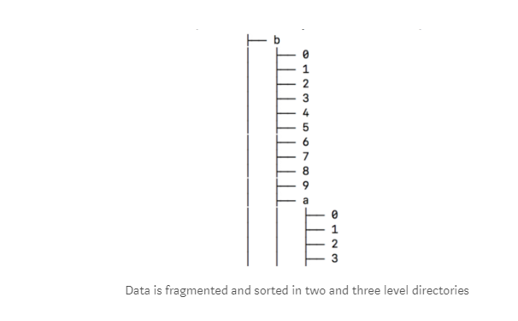
DataSets
Original archive of 41 GB having 1981 files were found on various social media blogs with common Pastebin link containing both compressed and uncompressed version of the archive
The data is structured in an alphabetic directory tree fragmented in 1,981 pieces to allow fast searches.
The dump includes search tools and insert scripts explained in a README file
https://medium.com/4iqdelvedeep/1-4-billion-clear-text-credentials-discovered-in-a-single-database-3131d0a1ae14
https://www.reddit.com/r/pwned/comments/7hhqfo/combination_of_many_breaches/

Slide 3

Data Cleaning and Preparation
Out of the total 1986 files
the total records- 1400553869 (1.4 Billion)
no of duplicates - 202281 were found. (202K- 0.014 %)
647701 (647K- 0.04 %) Records found with same EmailId and Passwords
105 Files were found with Invalid data with all NULL chars inside text files – total Size- 1.93 GB (4.8 %) (Out of Scope for Analysis)
2546790 (0.18 %) Records found with No passwords (Out of Scope for Analysis)
40140152 (2.86 %) Records found with less than 6 chars. (Out of Scope for Analysis)

Slide 4
Data Wrangling
Summary Dataset compiled grouped by EmailDomain and Password Length for Analysis and visualization.
S&P 500 Dataset with Sectors utilized to join against EmailDomain to discover corporate domains and sectors.
URLtools library was used to parse Email domain into domain, subdomain, suffix fields.

Slide 5
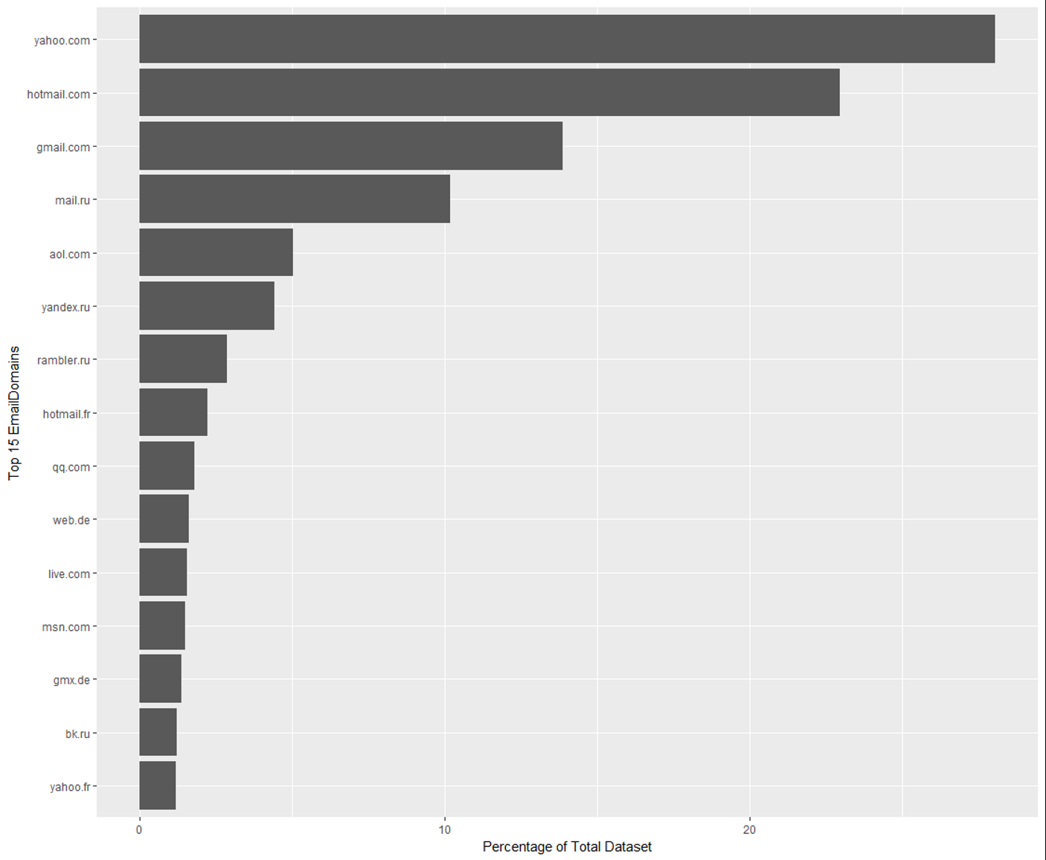
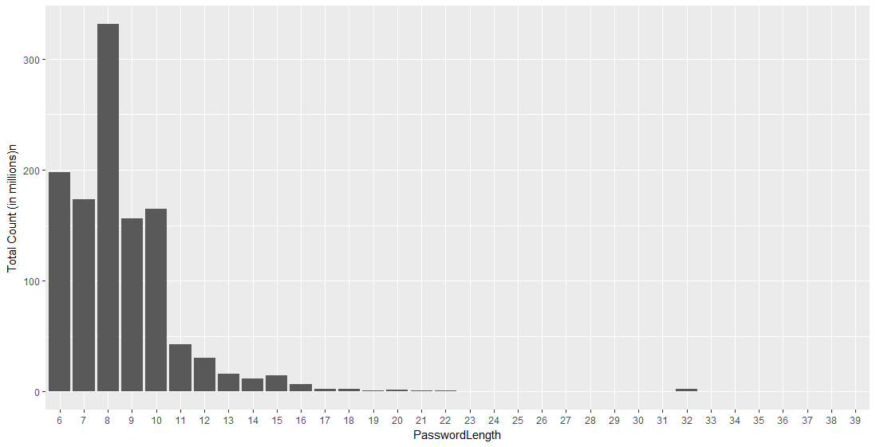
Data Visualization
Top 15 Email domains as compared to the total datasets.
Password length Histogram :
Majority of Passwords falling in 6 to 16 char length

Slide 6
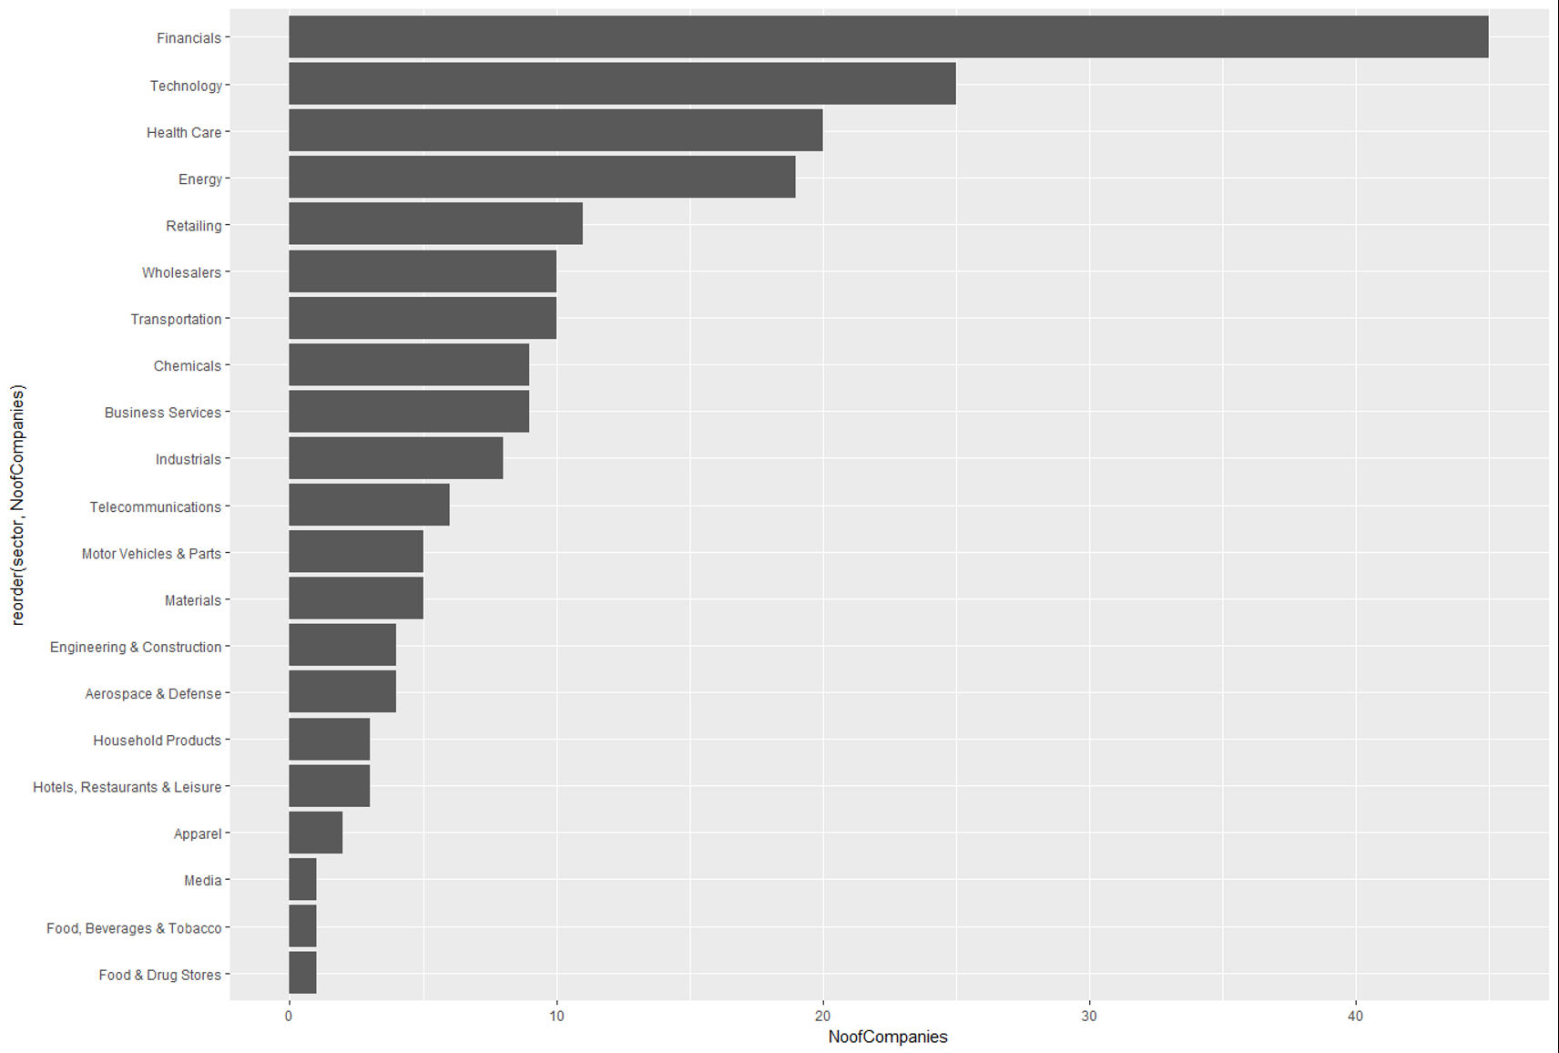
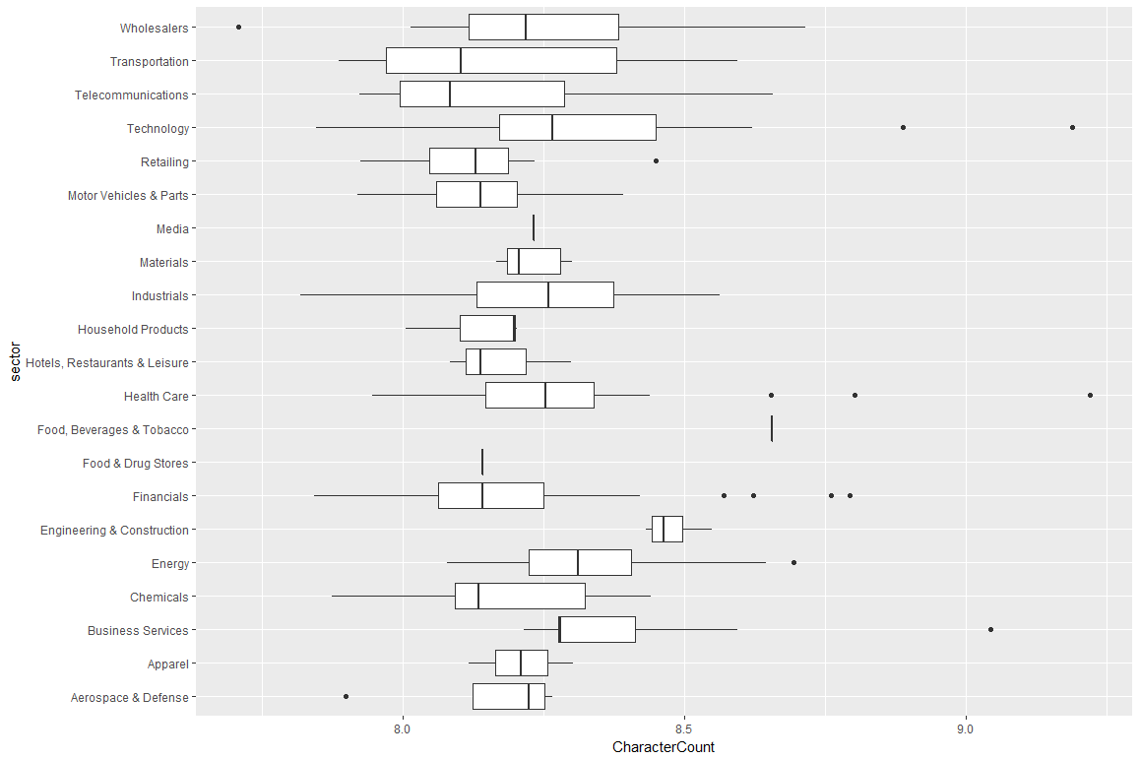
Data Visualization- continued…
Presence of 200 domains from S& P 500 companies
With more than 40 Financial Sector companies
Avg Password length of S&P 500 Sector companies in the dataset.

Slide 7
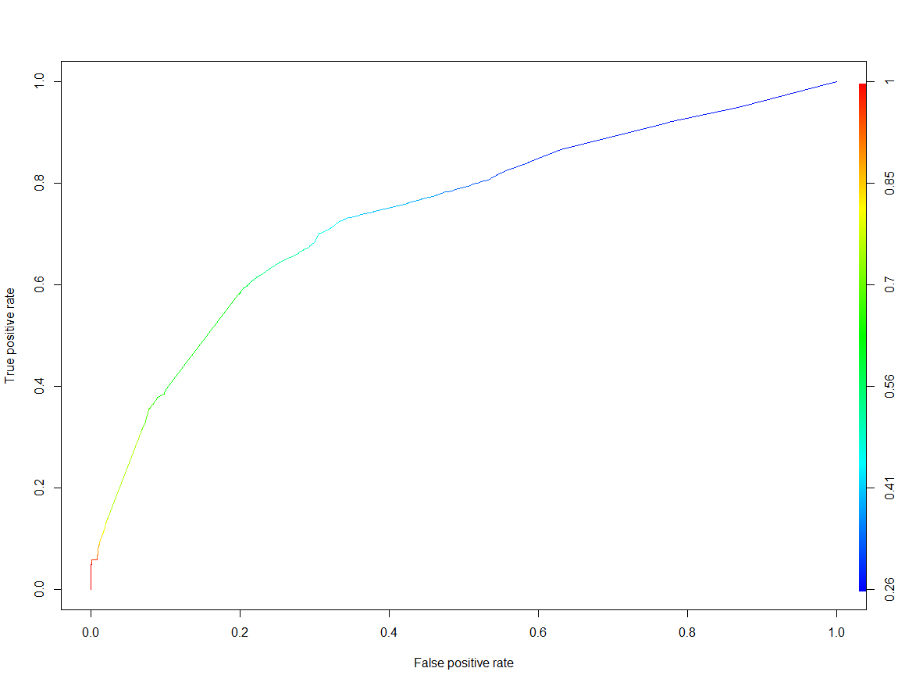
Logistic Regression
Can the regions be predicted from the password ?
Example dataset generated from gmail.co.uk and gmail.ru domain as test and training dataset.
The logistic function were generated based on the variables present in the dataset.
Punctuation and Cyrillic chars were found statistically insignificant.
Model accuracy of 68% was achieved.
ROC Curve - Diagnostic capability of the model as its threshold is varied

Slide 8
Conclusion
The breach compilation dataset had more than 200 Fortune 500 companies Emaildomain were present with more than 20 sectors.
Password length of the entire dataset varied from 6 to 16 char length where as avg password length per sector was between 8 to 9.
By training this dataset, one can try to predict the regions (UK/RU) based on given password with 68% accuracy.
Project Code Repo :
https://github.com/ashwin-patil/springboard-intro-to-datascience/tree/master/capstone_project
Detailed Technical Report :
Analysis of Passwords from BreachCompilation Dataset

